Slide 1
The PiCube
By Jacob Lightfoot and Scott Harwood

Slide 2
What the heck Is the PiCube then?
Well, it’s an LED Rubiks cube, which will be created by me(Jacob) and Scott, that should be able to be controlled and programmed through a Raspberry Pi. We’ll be using Python for our coding, and we’ll create the actual cube from scratch with the bits and bobs for creating said lighty-uppy-thingy from which we’ll need a couple of circuit boards (the weird green plastic stuff in computers) LEDs (powerful little lights. Short for Light Emitting Diode) and other stuff to keep it together and stop it from overloading/short circuiting (solder, pins, resistors etc.).

Slide 3
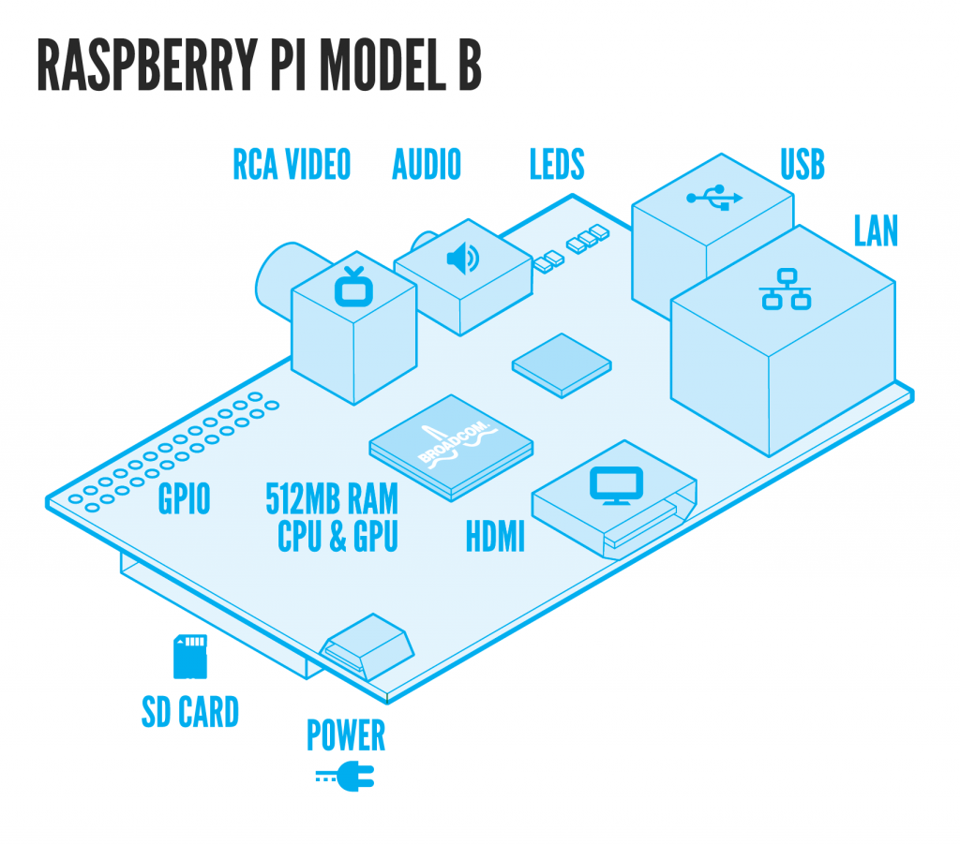
A Raspberry what-now and py-who?
A Raspberry Pi is a very small computer (and by very small mean credit card sized) which was created to try and get kids into coding. Not only is it very useful for learning these things its also very portable and easy to use for trials for different types of code. Python is the code that we will be using. We will use the module (sort of like an api) called PyGame to make the graphical cube.What it’ll let us code everything that needs to be coded.

Slide 4
So basically it’s a fancy electric cube?
Yes.

Slide 5
I have a feeling that probably means it’s going to be more complicated than your making out.
Yup.

Slide 6
Explanation?
Well, to put it basically as possible, first we’ve got to get the boards and the right amount of LEDs. They also have to be pretty high-end LEDs since we need multiple colours to colour the cube. The thing is the LEDs only have 3 colours (red, blue, green) to we’ll need to get ones that we’ll be able to code so that we can change the shade of the colours distinctly to have different colours on all 6 sides. We’ll probably need resistors to keep the LEDs from overloading from the amount of current input, and other bits for roughly the same reason (keep everything safe and secure. Then we’ll have to get solder (a metal alloy) to make sure it’s all together and doesn’t fall apart when we put it together. Then we’ll make a case for it (again probably from scratch) from a strong plastic so that we don’t damage the board. Then we get on to coding. First we code a 3D render of the cube on the Raspberry Pi so that we can control the Cube from the computer and not manually. Then we need to code the cube itself so that it follows the laws of the Rubik's cube (tiles can only go horizontally and vertically and always stay on the same section of the cube face) and also code the LEDs so that we can change the colours, which is more complicated than it sounds. Then we need to combine the two together to be able to code them both the work together in sync so that we are able to change the tiles on the computer screen cube to fit the tiles on the cube itself. We probably want to add a randomizer that also applies the laws of the Rubik’s cube.

Slide 7
I…See
To be fair it’s pretty hard to understand fully for both of us in some aspects of the creation and coding. It’ll take a lot of time and effort but we’ve already made real progress by sorting about half of the code out and buying all of the parts needed. I very much doubt anyone would be able to make you to fully understand every single aspect and we can’t because we don’t either. Just think of it as an over complication of something already complicated, Or even better, a shiny cube thingy.

